Slide 1
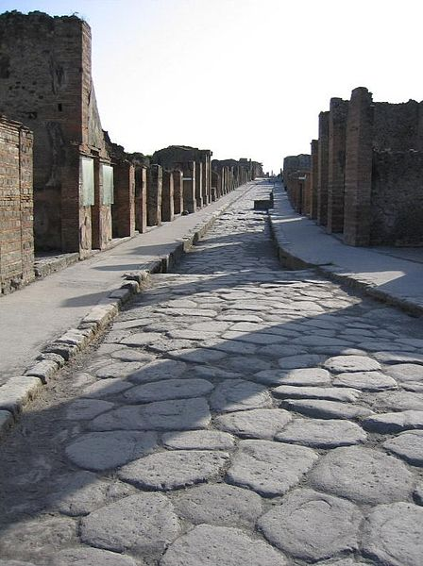
ROMAN ROADS

Slide 2
Overview
The Romans called the roads Viae
The Roman road system spanned more than 400,000 km of roads, including over 80,500 km of paved roads
The Roman roads were a vital part of the development of the Roman state, from about 500 BC through the expansion during the Roman Republic and the Roman Empire. Roman roads enabled the Romans to move armies and trade goods and to communicate .
There were footpaths on each side of the road. ^{[7]}

Slide 3
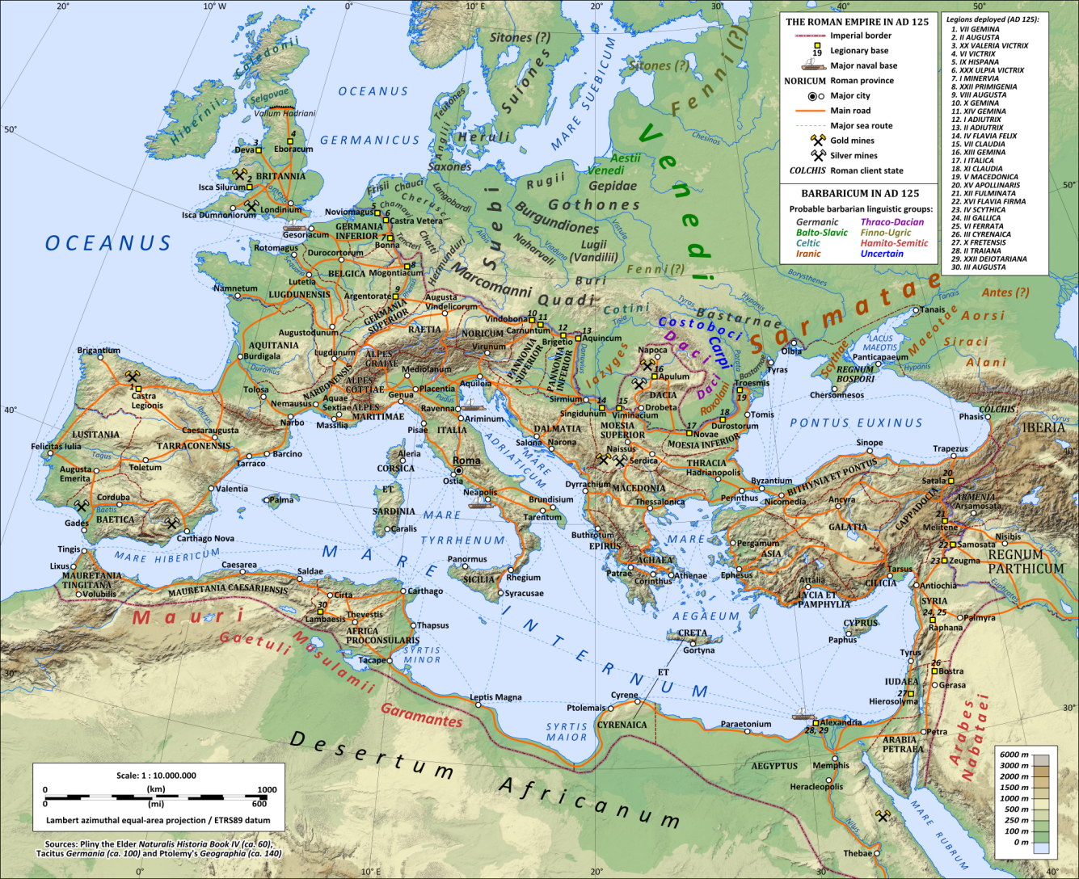

Slide 4
Construction
The Romans became adept at constructing roads.
They were intended for carrying material from one location to another. It was permitted to walk or pass and drive cattle, vehicles, or traffic of any description along the path.[
The viae differed from the many other smaller or rougher roads, bridle-paths, drifts, and tracks.
To make the roads the Romans used stones, broken stones mixed with cement and sand, cement mixed with broken tiles, curving stones - so the water could drain, and on the top they used tightly packed paving stones.
The Romans made their roads like walls.

Slide 5
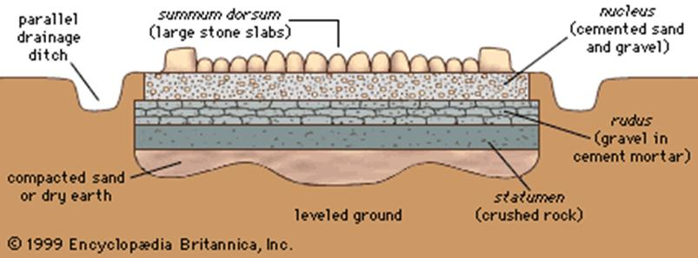
Roman Road

Slide 6
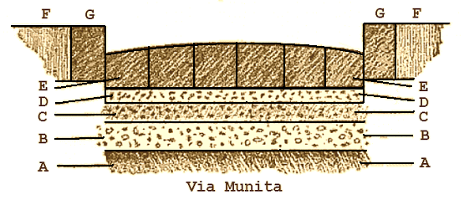
The general appearance of a road and footway is shown in an existing street of Pompeii.
(A). Native earth, levelled and, if necessary, rammed tight.
(B). Statumen: stones of a size to fill the hand.
(C). Audits: rubble or concrete of broken stones and lime.
(D). Nucleus : kernel or bedding of fine cement made of pounded potshards and lime.
(E). Dorsum or agger viae : the elliptical surface or crown of the road (media stratae eminentia) made of polygonal blocks of silex (basaltic lava) or rectangular blocks of saxum qitadratum (travertine, peperino, or other stone of the country). The upper surface was designed to cast off rain or water like the shell of a tortoise. The lower surfaces of the separate stones, here shown as flat, were sometimes cut to a point or edge in order to grasp the nucleus, or next layer, more firmly.
(F). Crepido, margo or semita : raised footway, or sidewalk, on each side of the via.
(G). Umbones or edge-stones.

Slide 7
The Roman road networks were important both in maintaining the stability of the empire and for its expansion.
The Roman legions made good time on them, and some are still used millennia later.
These roads played an important part in Roman military reverses by offering avenues of invasion to the barbarians.
The Roads also aided in the spread of Christianity

Slide 8
The Rise of Christianity
During the first century CE, a new religion took hold in Rome. It was called Christianity. The followers of Christianity were called Christians.
Christians believed in one god. They refused to worship the Roman gods. In ancient Rome, that was against the law. Christians were hunted as criminals.

Slide 9
Christianity
In spite of persecution, Christians grew in numbers rapidly. Christians actively looked for converts. They told others about the benefits of being Christian. Christians came from every walk of life in ancient Rome, but Christianity had great appeal to Rome's poor.
Life After Death: Christianity promised life after death in heaven. In the Roman religion, only gods went to heaven. Emperors were considered gods. Everyone else went to the underworld.
Equality: Christianity promised equal opportunity. You had to be born into the nobility. You could join Christianity and be equally a Christian.

Slide 10
Christianity
After nearly 300 years of persecution, in 313 CE, Emperor Constantine ruled that Christianity was legal and that Christians would no longer be persecuted for their beliefs.
This does not mean that Rome finally had religious freedom. It meant only that it now legal to worship Roman gods or to be Christian. Every other religion was still illegal.
The lack of religious freedom in ancient Rome contributed to the fall of the Roman Empire.

Slide 11
The Fall of Rome
As the Roman Empire was growing it was more difficult to control from Rome
Two Roman Empires were created
The Western Empire – Rome remained the capital
The Eastern Empire – Constantinople became the 2nd capital
This is the start of a slow decline that occurred over a period of approximately 320 years

Slide 12
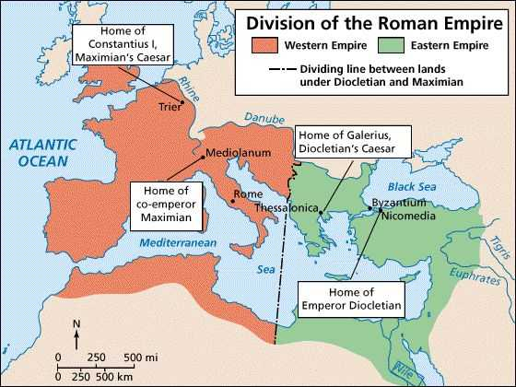

Slide 13
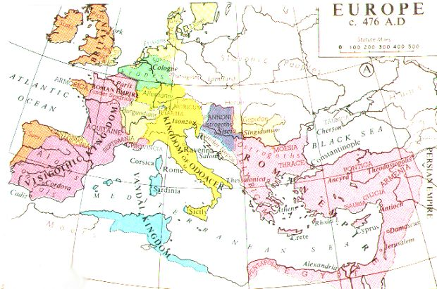
The year 476 CE is generally accepted as the “Fall of the Roman Empire”

Slide 14
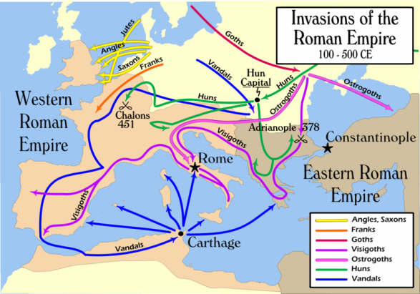

Slide 15
Reasons for the Fall of Rome
1) Military weakens
    Having a military that consisted of conquered troops was not working anymore
    Constant fighting to maintain its borders
    The was especially true in Germania under the rule of Odoacer
    Other people invaded and people were reluctant to fight for the Roman Legion anymore
    Also troops were very tired of constantly being at war

Slide 16
Reasons for the Fall of Rome
2) Economy was very weakened
The Empire was huge and grew very fast
It required large sums of money for its infrastructure
Coinage was not being made of pure silver anymore
Taxes were also consistently raised which raises inflation and caused major economic stresses on the Empire

Slide 17
Reasons for the fall of Rome
3) Growth of Christianity
  Many people liked the idea of the afterlife that went along with Christianity
  They also like the ideas of equality – Especially the poor
  Many people weren’t as interested in the ways of Rome because the were willing to wait for the rewards of Heaven.

