Slide 1
Greek/Roman Gods

Slide 2
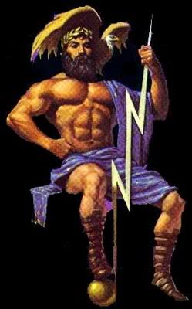
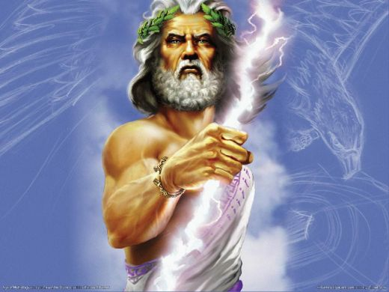
King of the gods
Zeus
Jupiter

Slide 3
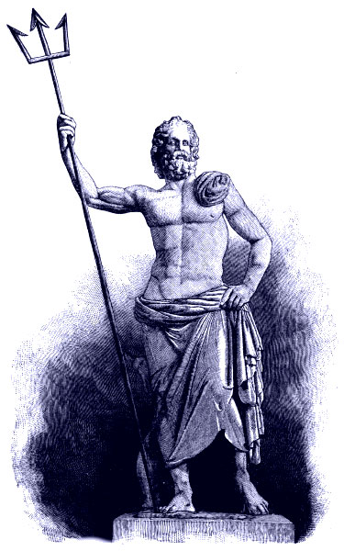
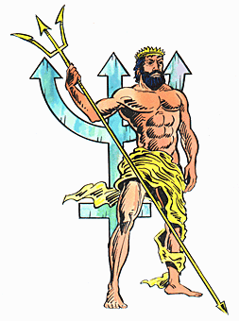
God of the Sea
Poseidon
Neptune

Slide 4
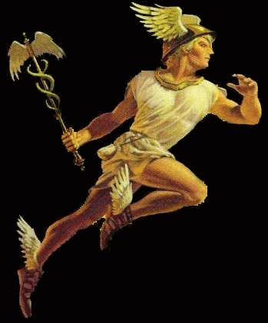
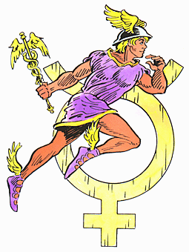
Messenger God
Hermes
Mercury

Slide 5
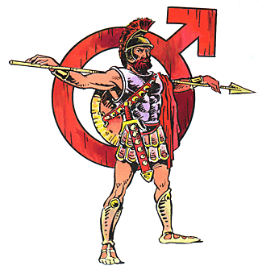
God of War
Ares
Mars

Slide 6
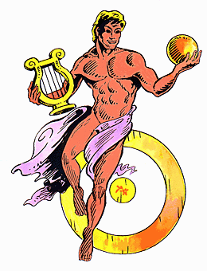
God of the Sun
Apollo
Apollo

Slide 7
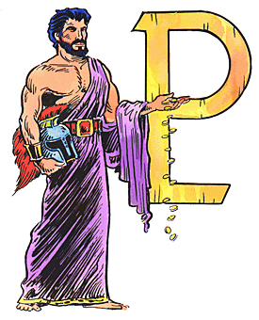
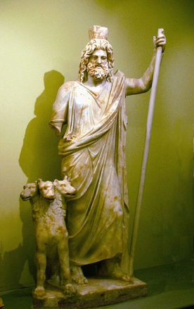
God of the Underworld
Hades
Pluto

Slide 8
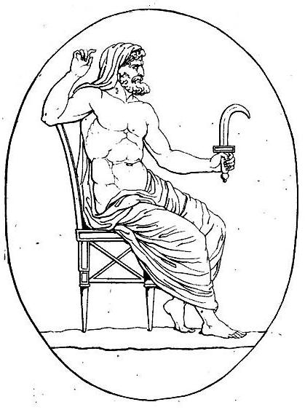
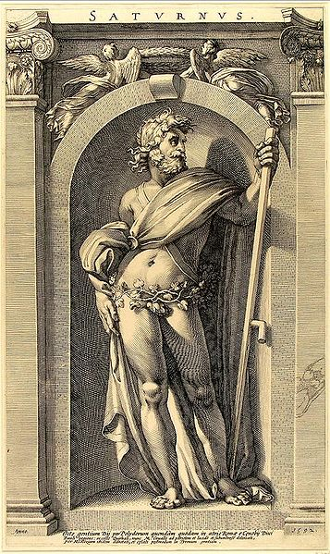
God of good Harvest and Agriculture
Cronus
Saturn

Slide 9
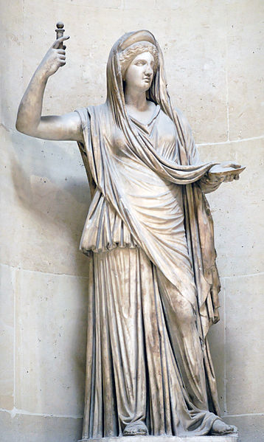
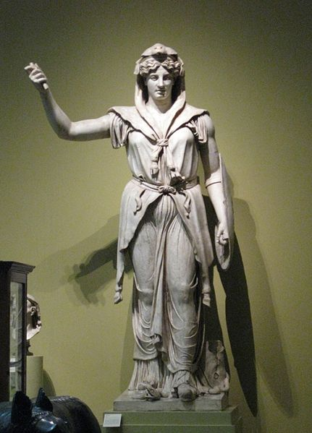
Queen of the Gods
Hera
Juno

Slide 10
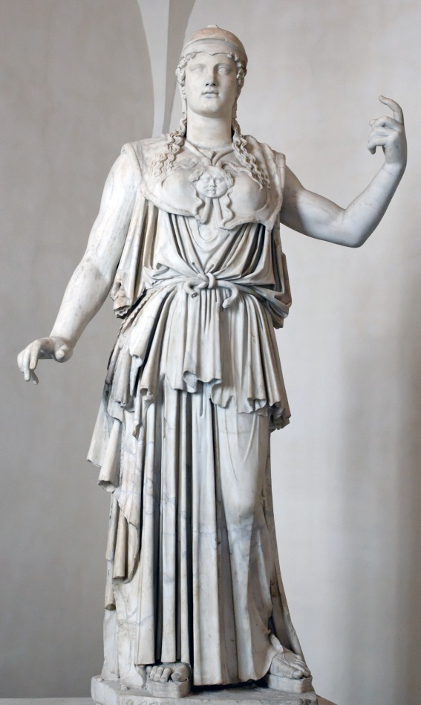
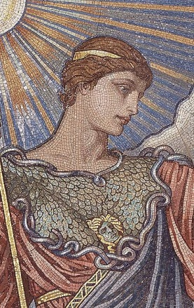
Goddess of Wisdom, Arts and Defense in War
Athena
Minerva

Slide 11
Assignment
You will create a presentation on a Greek/Roman god – Use Prezi or Powerpoint
What I need:
A Greek god and a Roman god that is similar in what they represent
What they represent
Their story of origin – Genealogy (relatives)
Why this god is important – what did he/she give the people
If there is any, relics, symbols, monuments that represent the god
Why do you feel that these societies needed this good

