Slide 1
Geography of Greece and It’s Influences
1000 BCE – 300 BCE

Slide 6
Mountainous peninsula that goes into the eastern Mediterranean Sea
25% of the land can be cultivated
Mild Climate (Grapes, Olive Trees)
Coastline very rough and mountainous
Jutting coast (like fingers) – Natural Harbours
Near the sea – Developed transportation

Slide 7
Greek Wine
Greece is one of the oldest wine-producing regions in the world.
The earliest evidence of Greek wine has been dated to 6,500 years ago where wine was produced on a household or communal basis.
In ancient times, as trade in wine became extensive, it was transported from end to end of the Mediterranean

Slide 8
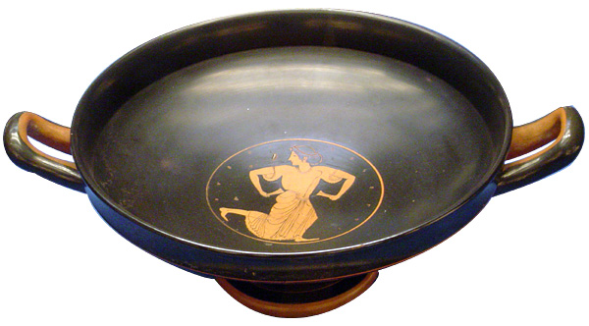
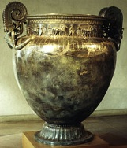
Greek Wine Cups and Containers

Slide 9
Greek Olive Oil

Slide 10
Uses for Olive Oil
It was a gift from the goddess Athena to the Athenians
Daily Uses - Used for cooking, salads and perfume
Medicinal - Used to heal scratches wounds and contusions
Used to anoint the athletes at the Olympic Games

Slide 11
Very Mild Climate
Lots of time spent outside
Had to turn to fishing and trade because of lack of farm land
Mountains separated the country. Hard to unite
Trade introduced Greeks to other civilizations . Open to new ideas.
Greece was broken up into individual city states – Called Polis

Slide 14
Greek Society was mainly broken up between Free people and Slaves, who were owned by the free people.
Citizens
Metics
Slaves
Free People

Slide 15
Citizens
A citizen was born with Athenian parents
They were the most powerful group, that could take part in the government of the Polis.
After compulsory service in the army they were expected to be government officials and take part in Jury Service.

Slide 16
Metics
A metic was of foreign birth that had migrated to Athens, to either trade or practice a craft.
A metic had to pay taxes and sometimes required to serve in the army.
However, they could never achieve full rights of a Citizen, neither could they own houses or land and were not allowed to speak in law courts

Slide 17
Slaves
Slaves were used as servants and labourers, without any legal rights.
Sometimes the slaves were prisoners of war or bought from foreign slave traders.
Although many slaves lived closely with their owners, few were skilled craftsmen and even fewer were paid.

Slide 18
Women
The social classes applied to men only, as women all took their social and legal status from their husband or their male partner.
Women in ancient Greece were not permitted to take part in public life.

Slide 19
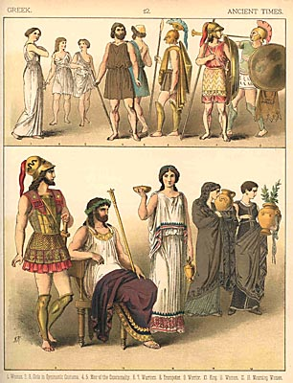
Ancient Greek People

Slide 20
Qualifications of a citizen
Only who were property owners and whose parents had been citizens
Foreign-born people and females were barred
1) Duties of a citizen
Develop political ability through self-government
Develop physical and artistic abilities through attendance at gymnasiums and theaters
Had to serve in the army and share in governing the city-state

Slide 21
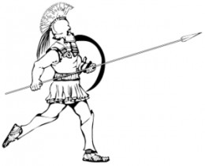
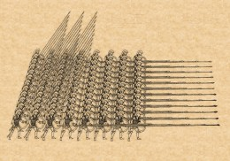
Hoplite Phalanx

Slide 22
Rights of the citizen
Every citizen given a voice in government
Free to have political discussions
Slaves did all the work for these people so they could concentrate on local affairs

Slide 25
Greek Democracy
In Athens, only citizens got the right to vote (Land owning males, with Athenian heritage)
This was only 1/3 of the population of Athens and surrounding area
There were different bodies of government with different responsibilities but….
It was a form of Direct democracy – Each citizen got to vote on laws or legislation directly

Slide 26
Greek Democracy
We are going to make decisions in class based on the Greek form of Democracy.
First Decision - You can wear a hat in class
Second Decision – 100% final Exam
Third Decision – The Girls can leave class early

